Slide 1
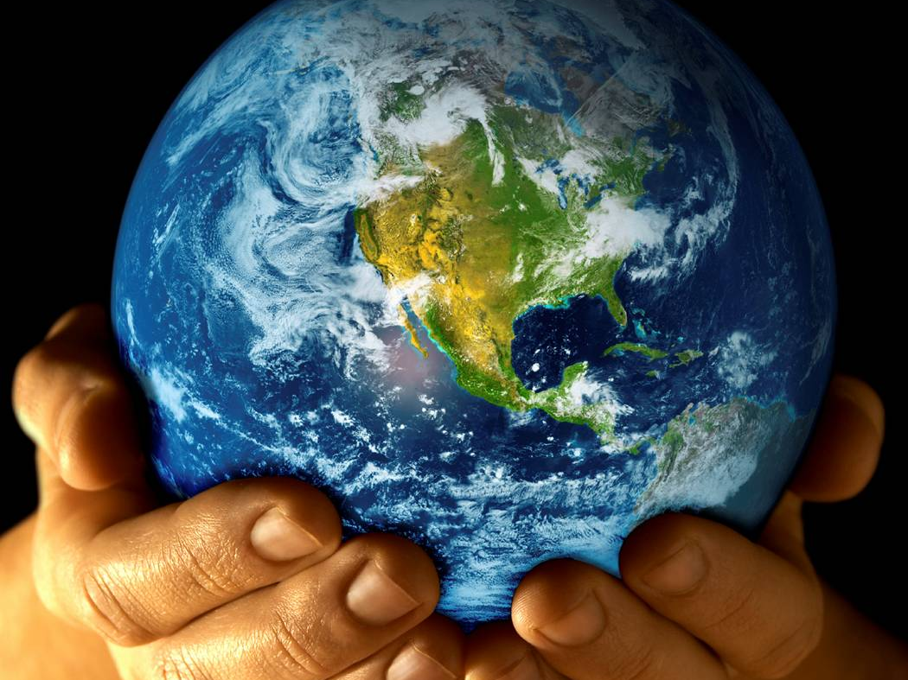
NO MATTER
WHAT

Slide 2
NO MATTER WHAT
No matter what this old World dishes out,
No matter what, I have no doubt,
No matter what,
Your grace is sufficient for me.

Slide 3
No matter what this old World dishes out,
No matter what, I have no doubt,
No matter what,
Your grace is sufficient for me.

Slide 4
A little boy sitting in a market place
With dirt on his hands and hunger on his face.
He doesn’t know where his next meal’s coming from.
His mum’s so poor, he can’t find his dad.
Things don’t look good, Oh, they look so bad,
but that little boy’s got a smile on his face instead.

Slide 5
No matter what this old World dishes out,
No matter what, I have no doubt,
No matter what,
Your grace is sufficient for me.

Slide 6
No matter what this old World dishes out,
No matter what, I have no doubt,
No matter what,
Your grace is sufficient for me.

Slide 7
A little old lady in a waiting room,
Her husband’s very ill, could be gone soon.
She sits there waiting with a sad, sad tear in her eye
They’ve been together more than fifty years
They’ve shared their laughter and they’ve shared their tears
And they’ve shared the precious love of God in their lives.

Slide 8
No matter what this old World dishes out,
No matter what, I have no doubt,
No matter what,
Your grace is sufficient for me.

Slide 9
No matter what this old World dishes out,
No matter what, I have no doubt,
No matter what,
Your grace is sufficient for me.

Slide 10
A young man working in the dead of night
Too much to do, he’s stretched so tight
He doesn’t know how he’ll make it
through the day.
A teenage girl, with a boyfriend gone,
There’s nothing worse than being alone.
Her skies have turned from blue to
cloudy grey.

Slide 11
No matter what this old World dishes out,
No matter what, I have no doubt,
No matter what,
Your grace is sufficient for me.

Slide 12
No matter what this old World dishes out,
No matter what, I have no doubt,
No matter what,
Your grace is sufficient for me.

